Slide 1
RNNs, Attention, and Transformers

Slide 2
Refernces
Bahdanau, D., Cho, K., & Bengio, Y. (2014). Neural machine translation by jointly learning to align and translate. arXiv preprint arXiv:1409.0473.
Vaswani, A., Shazeer, N., Parmar, N., Uszkoreit, J., Jones, L., Gomez, A. N., ... & Polosukhin, I. (2017). Attention is all you need. In Advances in neural information processing systems (pp. 5998-6008)
Alammar, Jay (2018). The Illustrated Transformer
Adaloglou, N. and Karagiannakos, S. (2020), How attention works in deep learning: understanding the attention mechanism in sequence models.

Slide 3
Recurrent Networks
Some problems require previous history/context in order to be able to give proper output (speech recognition, stock forecasting, target tracking, etc.)
One way to do that is to just provide all the necessary context in one "snap-shot" and use standard learning
How big should the snap-shot be? Varies for different instances of the problem.

Slide 4
Motivation
Not all problems can be converted into one with fixed length inputs and outputs
Problems such as Speech Recognition or Time-series Prediction require a system to store and use context information
  Simple case: Output YES if the number of 1s is even, else NO
  1000010101 – YES, 100011 – NO, …
Hard/Impossible to choose a fixed context window
  There can always be a new sample longer than anything seen

Slide 5
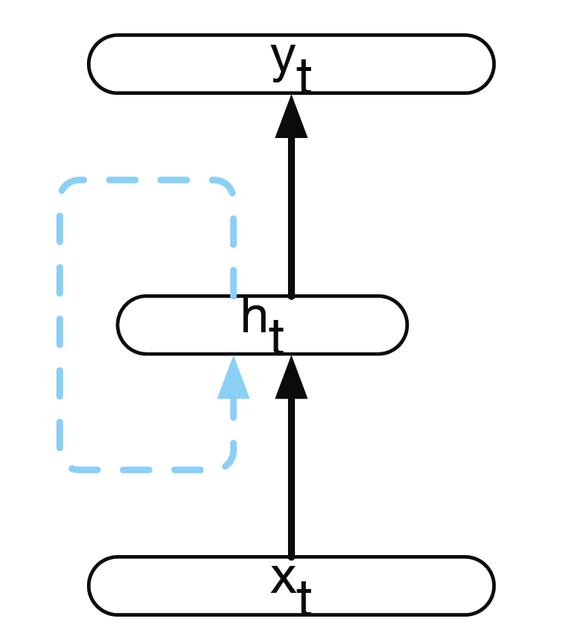
Recurrent Neural Networks (RNNs)
RNNs take the previous output or
hidden states as inputs!
The composite input at time t has some historical
information about the happenings at time T < t
RNNs are useful as their intermediate values (state) can store information about past inputs for a time that is not
fixed a priori

Slide 6
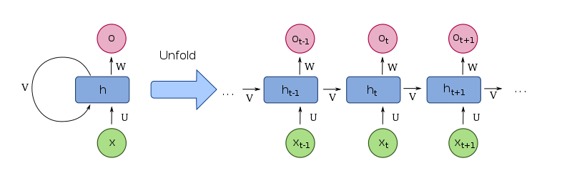
Recurrent Neural Networks (RNNs)

Slide 7

Inference in Simple RNNs
$h_{t}=g(V$ $h_{t−1}+Ux_{t})$
$o_{t}=f($W $h_{t}$)

Slide 8
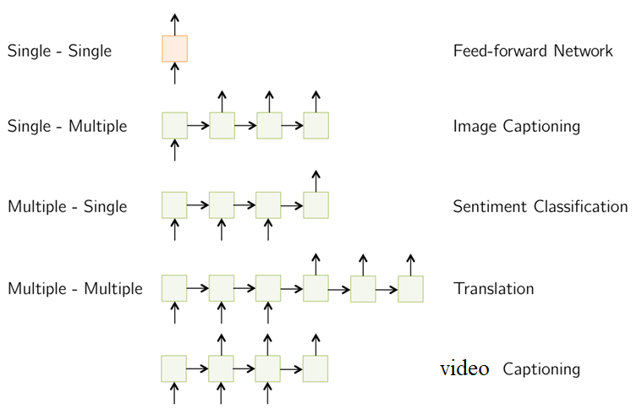
RNNs applications

Slide 9
RNN
Advantages:
  Possibility of processing input of any length
  Model size not increasing with size of input
  Computation takes into account historical information
  Weights are shared across time
Shortcomings:
  Hard to parallelize because of the sequential nature of RNNs
  Difficulty of learning long-range dependencies
  Cannot consider any future input for the current state
https://stanford.edu/~shervine/teaching/cs-230/cheatsheet-recurrent-neural-networks
Notes:
کدام مورد از مزایای شبکه RNN نیست؟
۱) پردازش ورودی با طول زیاد
۲)‌ تعداد پارامتر یکسان برای هر اندازه ورودی
۳) یادگیری ارتباطات بین کلمات با هر فاصله‌ای از یکدیگر در وردی.
۴) در نظر گرفتن تاریخچه

Slide 10
Attention

Slide 11
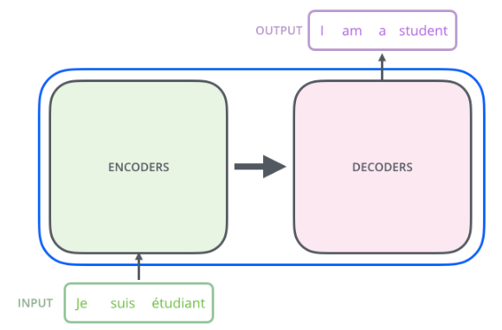
Encoder-decoder networks
Used in a wide range of applications including machine translation, summarization, question answering, and dialogue modeling.
RNNs were the most widely-used and successful architecture for both the encoder and decoder.

Slide 12
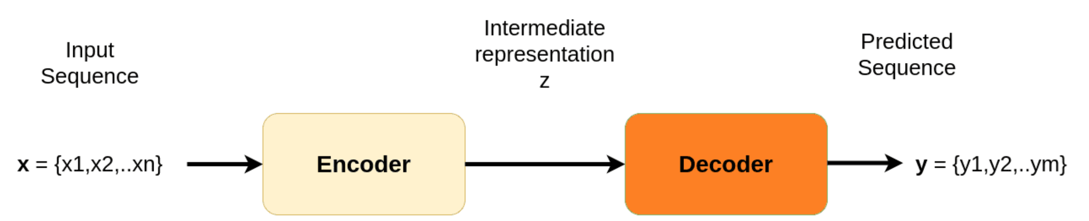
Encoder-decoder: seq2seq
https://theaisummer.com/attention/

Slide 13
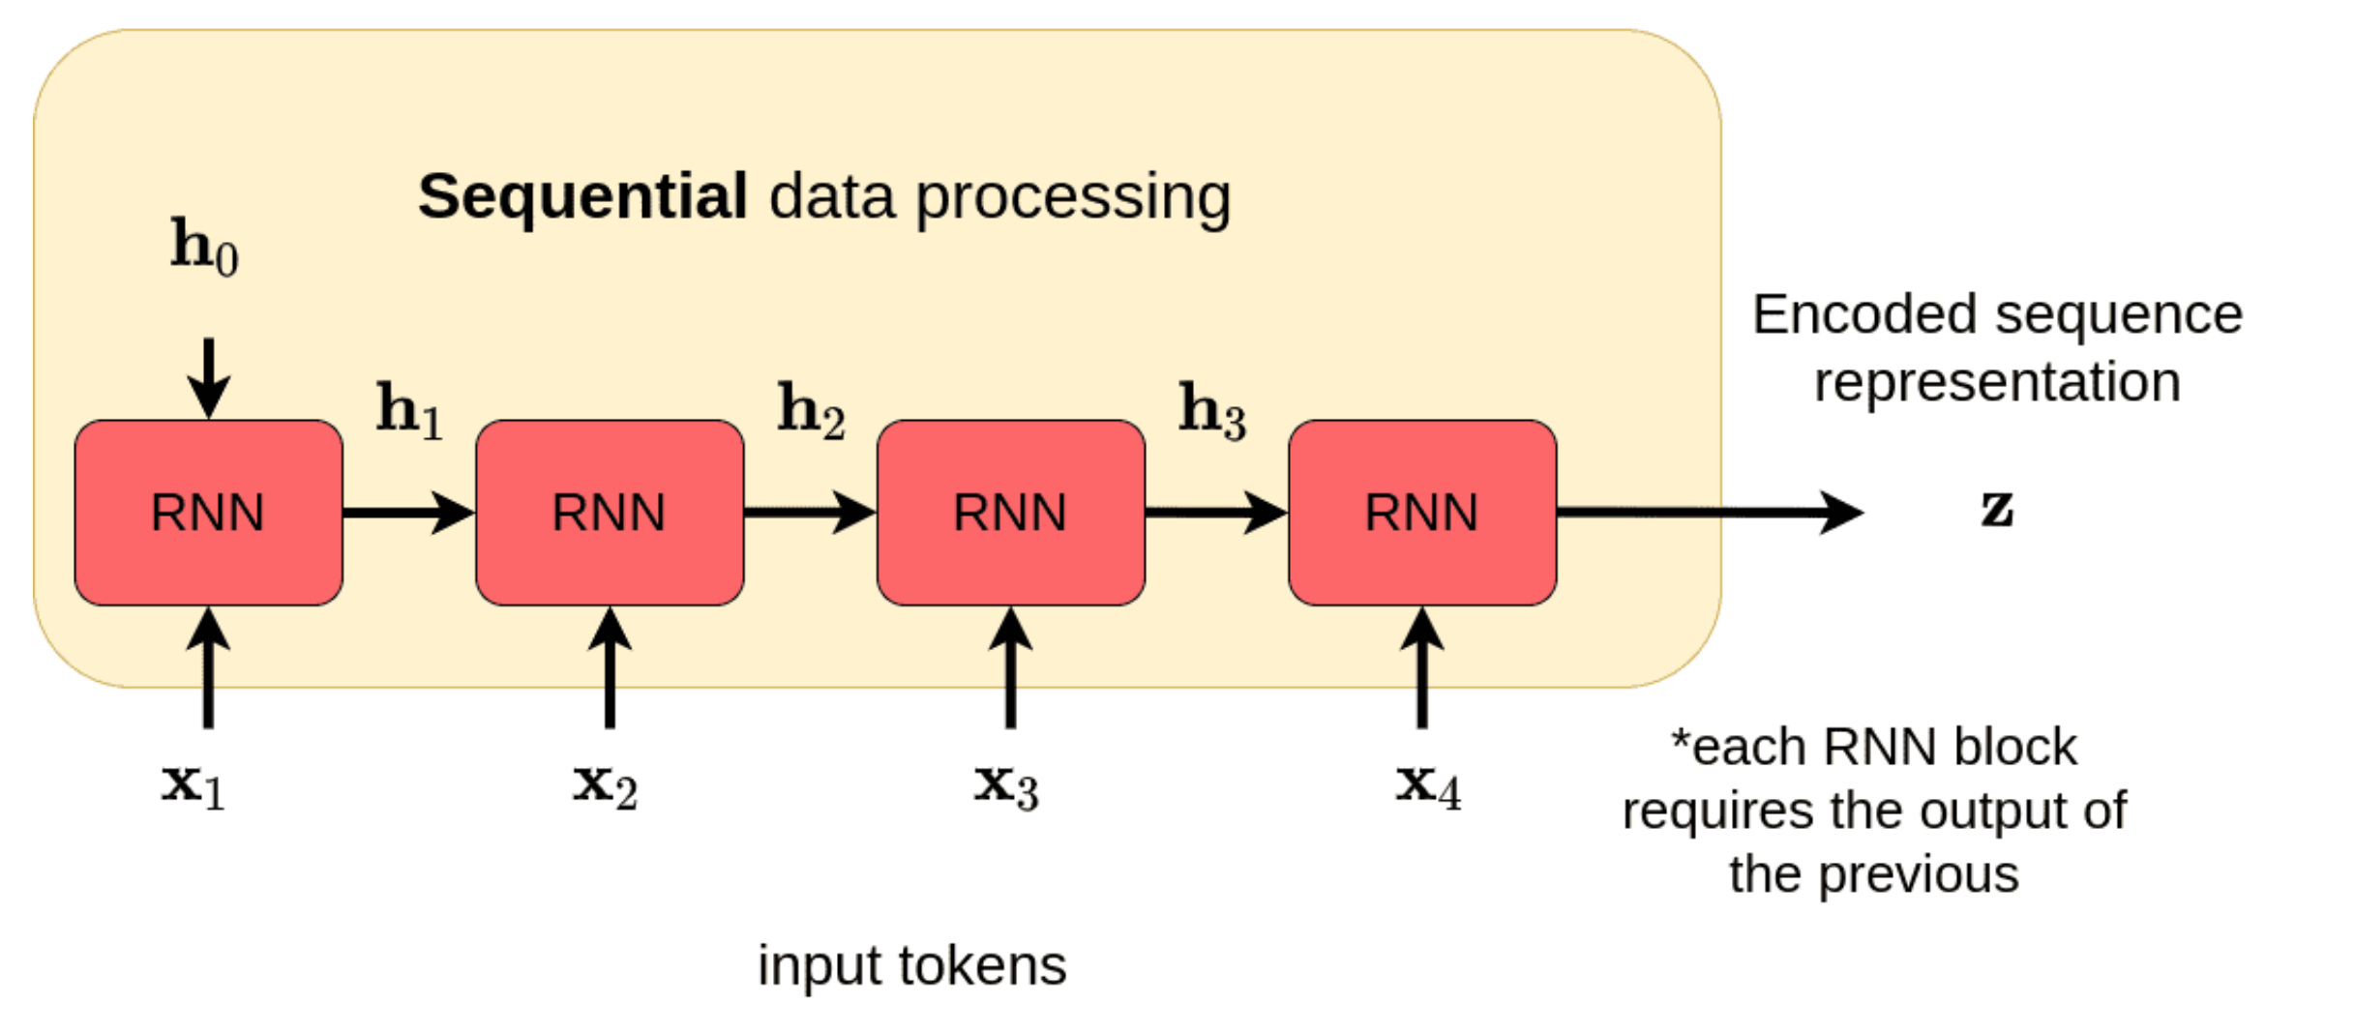
Encoding with RNNs

Slide 14
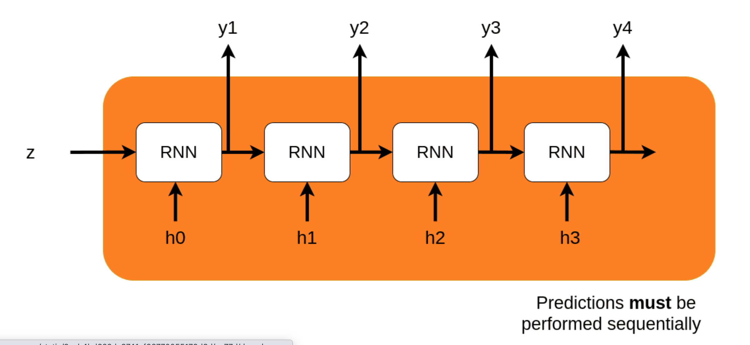
Decoding with RNNs

Slide 15
What if sequence length is high (say > 30)?
The vector z needs to capture all the information about the source sentence.
Notes:
The intermediate representation z cannot encode information from all the input timesteps. This is commonly known as the bottleneck problem. The vector z needs to capture all the information about the source sentence.
In theory, mathematics indicate that this is possible. However in practice, how far we can see in the past (the so-called reference window) is finite. RNN’s tend to forget information from timesteps that are far behind.

Slide 16
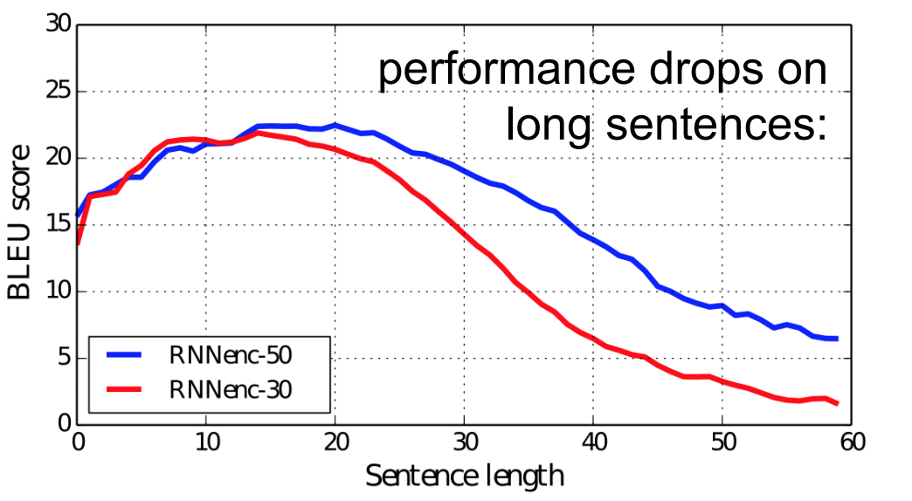
fixed size representation can be the bottleneck

Slide 17
The core idea of attention is that the context vector z should have access to all parts of the input sequence instead of just the last one.

Slide 18
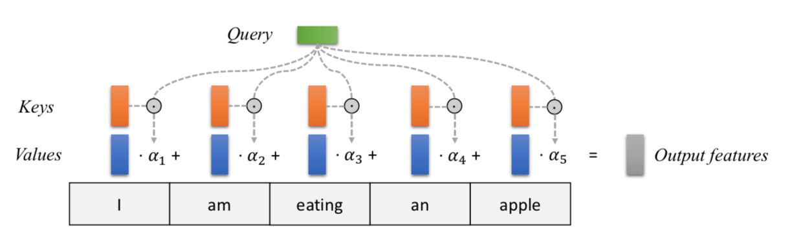

Attention
A weighted average of (sequence) elements with the weights depending on an input query.
The idea and the name taken from the intuition that humans attend to certain things at each time.
$⍺_{i}$are data-dependent dynamic weights

Slide 19
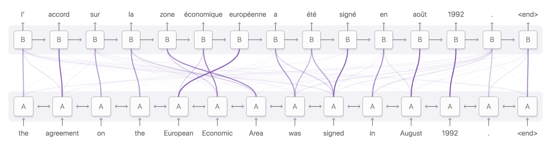
MT
Notes:
the model learned to swap the order of words in translation. Also note that this is not a 1-1 relationship but a 1 to many, meaning that an output word is affected by more than one input word (each one with different importance).

Slide 20
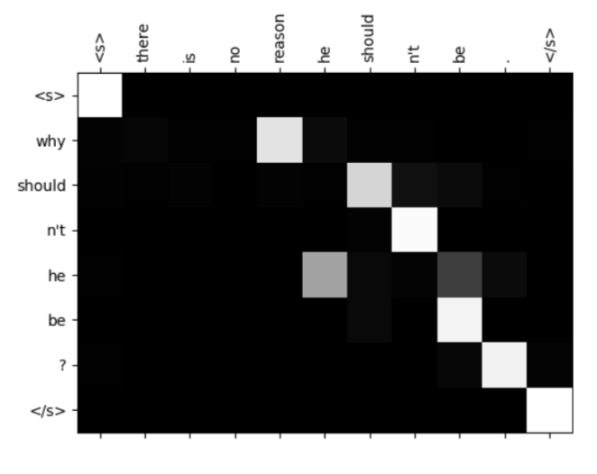
Cross-Attention
Input: two sentences or sequences
Task: reason/compare those sentences
Attention: queries for each word from one sentences, key and value for each word from second sentence
Applications: paraphrasing, natural language inference, question answering

Slide 21
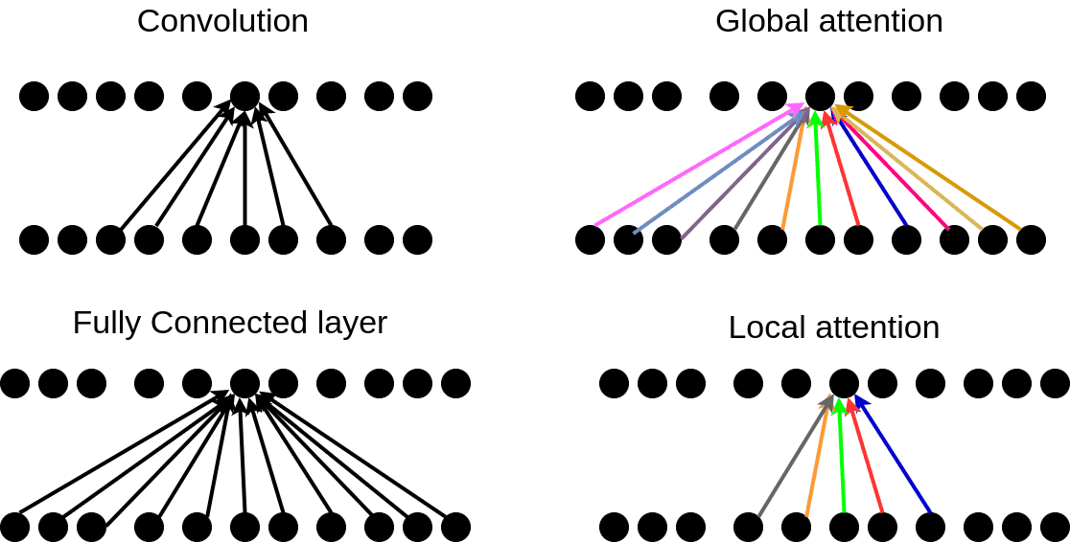
The colors in the attention indicate that these weights are constantly changing while in convolution and fully connected layers they are slowly changing by gradient descent.
In local attention, we consider only a subset of the input units/tokens.
Notes:
we also have hard and soft attentions

Slide 22
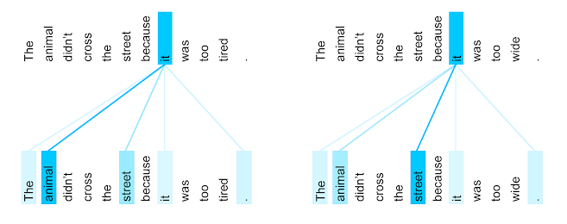
Self-Attention
For each word, self-attention allows the model to look at other positions in the input for a better encoding for this word.

Slide 23
Transformer

Slide 24
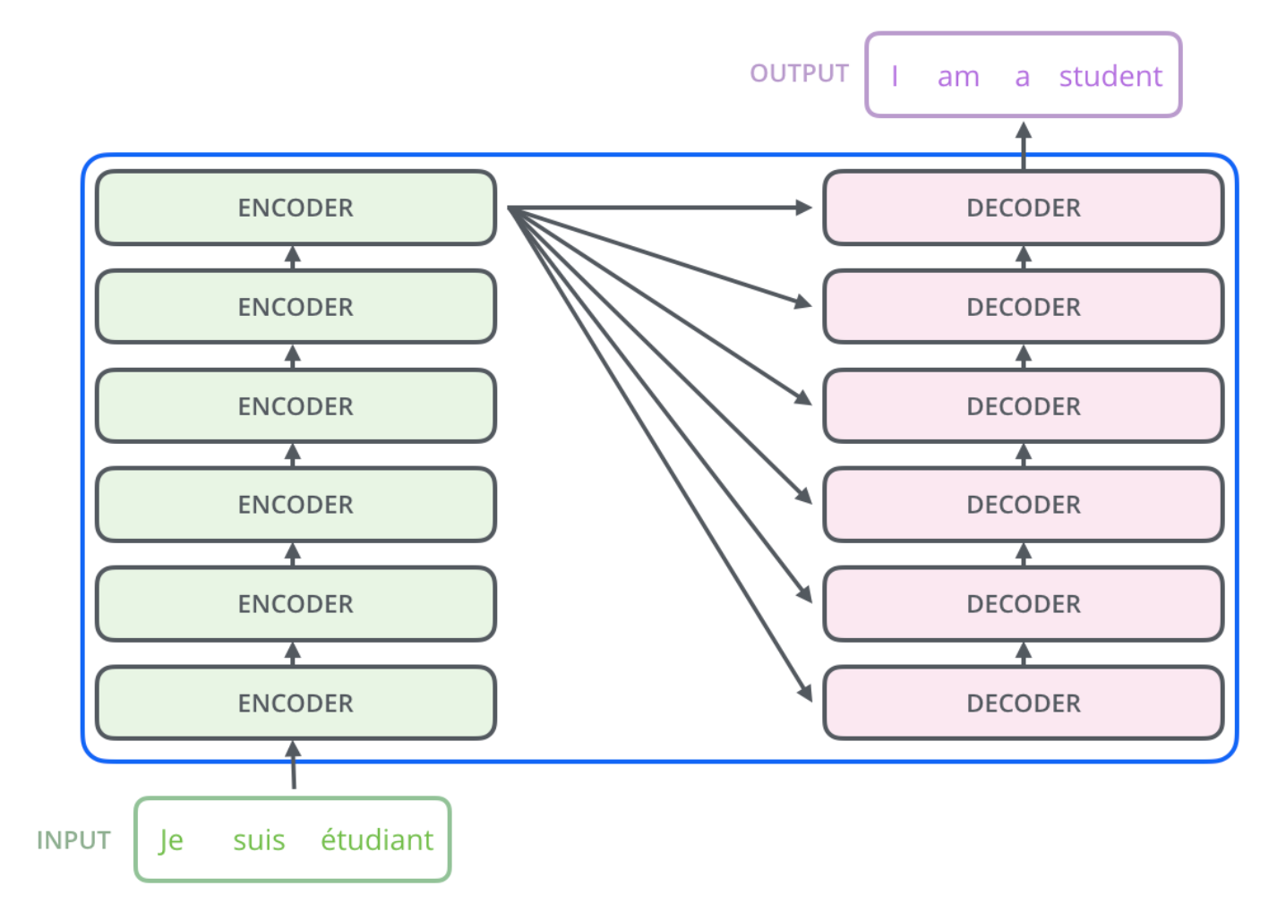
Transformer Model
http://jalammar.github.io/illustrated-transformer/

Slide 25
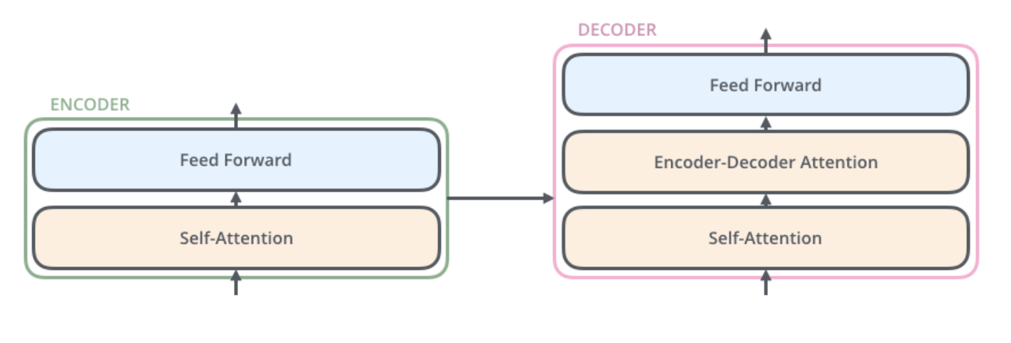
Transformer Model
http://jalammar.github.io/illustrated-transformer/

Slide 26
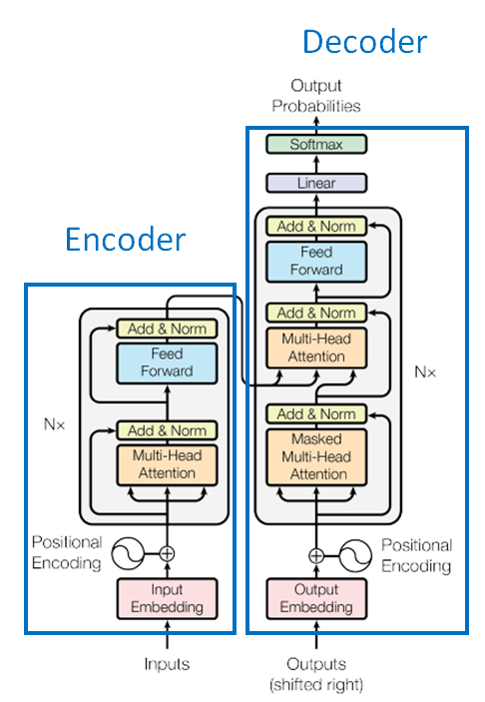
Transformer model
Non-recurrent sequence to sequence encoder-decoder model
  Eliminate recurrence, allows for significantly more parallelization
Three kinds of attentions:
  The input and output tokens (solved by traditional attention mechanism)
  The input tokens themselves
  The output tokens themselves
Extend the (self-)attention mechanism to processing input and output sentences as well.

Slide 27
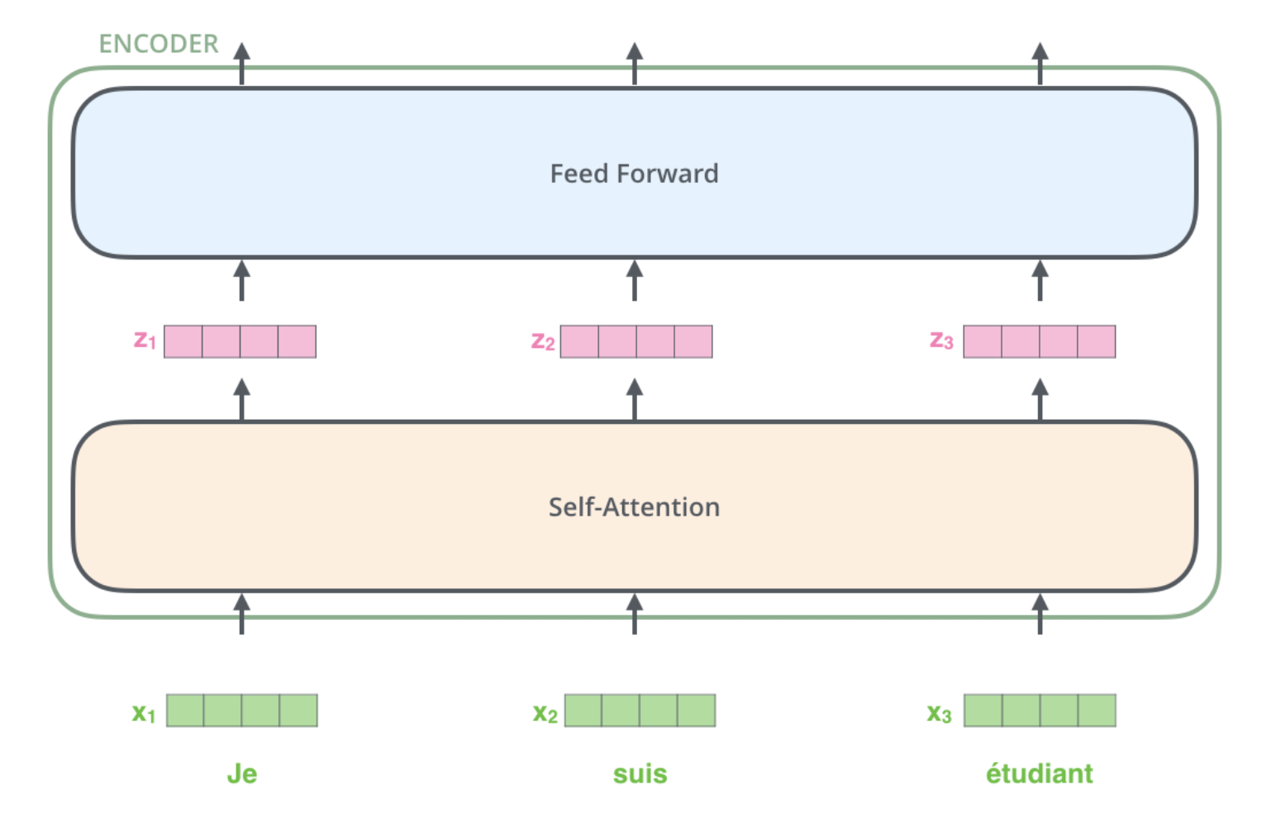
Encoder

Slide 28
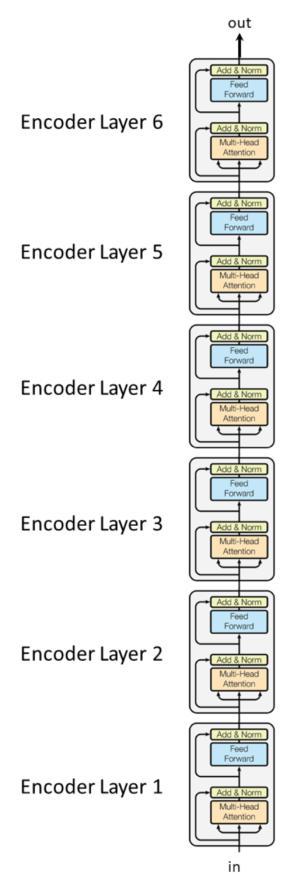
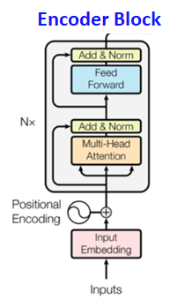
Encoder
The encoder composed of N blocks (N = 6)
Each block composed of two sub-layers
  1. Multi-head self-attention layer
  2. fully connected feed-forward network
  Residual connection followed by a layer normalization between each sub-layer
    LayerNorm(x + Sublayer(x))
    Faster training and regularization

Slide 29
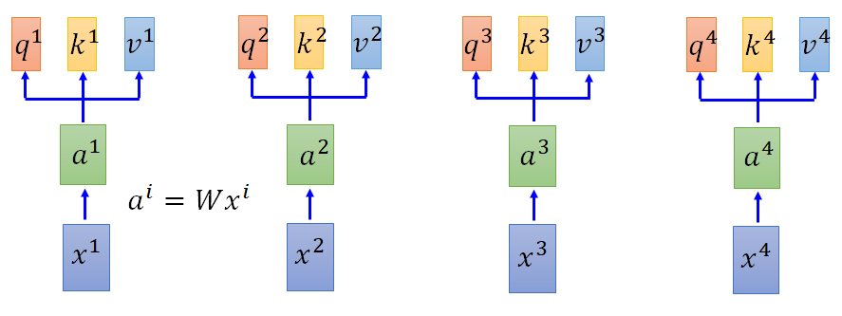



Self-Attention in Transformers
Three vectors for each of the input vectors
  A Query vector
  A Key vector
  A Value vector
$$q^{i}=W^{q}a^{i}$$
$$k^{i}=W^{k}a^{i}$$
$$v^{i}=W^{v}a^{i}$$

Slide 30



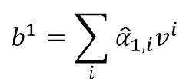
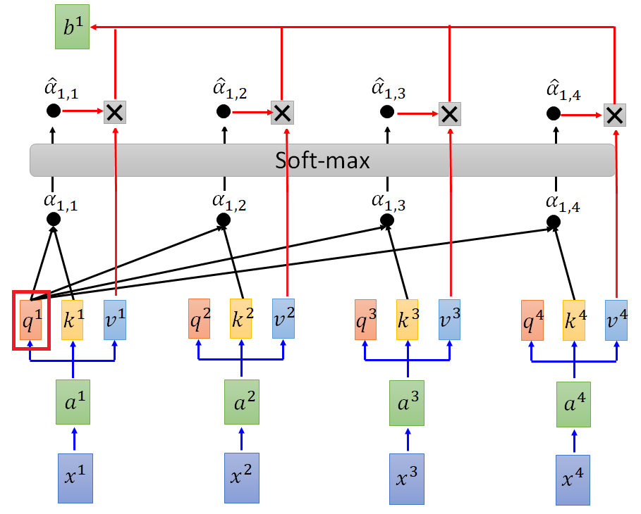
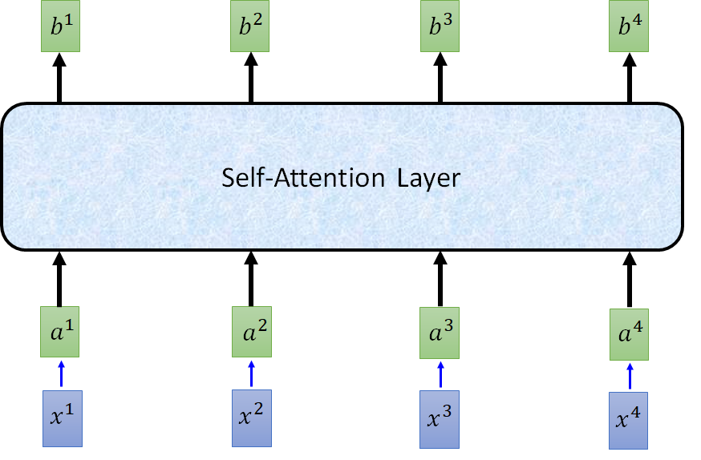
Self-Attention in Transformers
For large values of 𝑑_{k}, the dot products grow into huge values, pushing the 𝑠𝑜𝑓𝑡𝑚𝑎𝑥 function into regions where it has extremely small gradients, so the dot-product is scaled by 𝑑_{k} (length of query/key vectors).

Slide 31
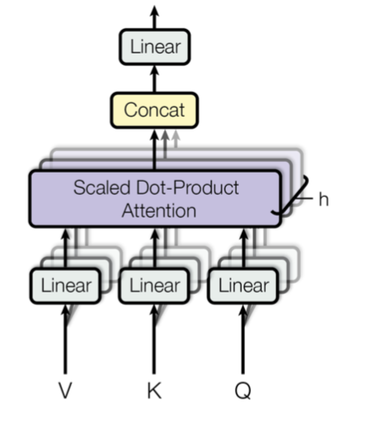
Multi-Head Self-Attention
Single head offers only one perspective on the data ⇒ Often not enough
Performing several self-attentions in parallel increases flexibility and non-linearity/complexity
Output projection to scale down the concatenation if necessary

Slide 32
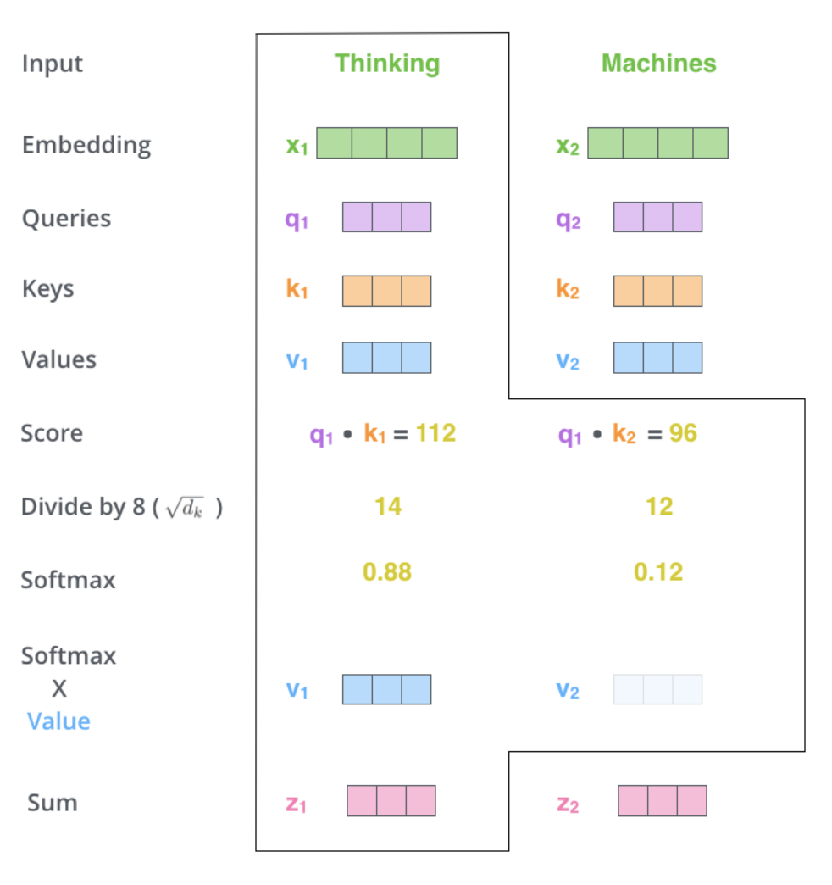
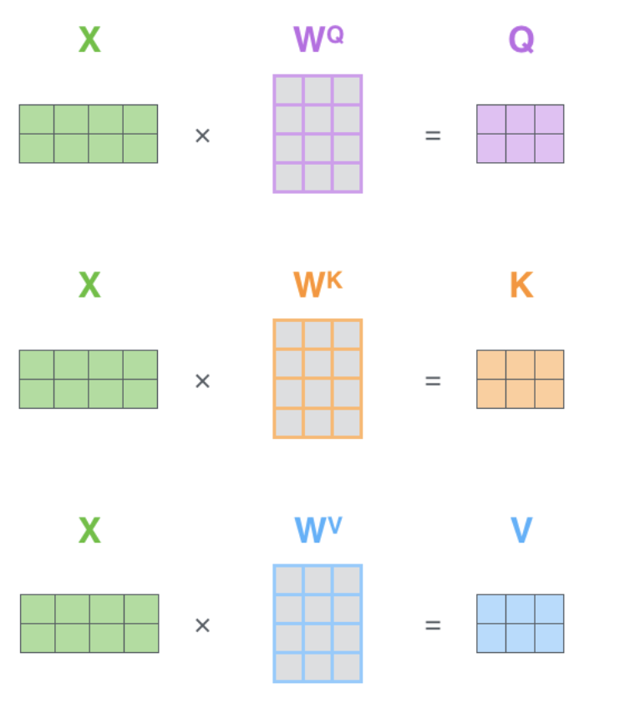

Slide 33
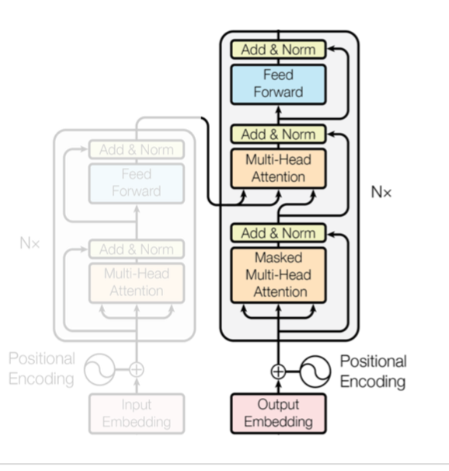
Decoder
Composed of 3 sub-layers
  1. Masked Multi-head attention
  2. Encoder-Decoder Attention
  3. Fully connected feed-forward network
Masked Multi-head attention:
  The self-attention layer is only allowed to attend to earlier positions in the output sequence
  Masks the “future” tokens when decoding a certain word (setting them to -inf)
Encoder-Decoder Attention layer:
  Queries come from the layer below it
  Keys and Values come from the output of the encoder stack

Slide 34
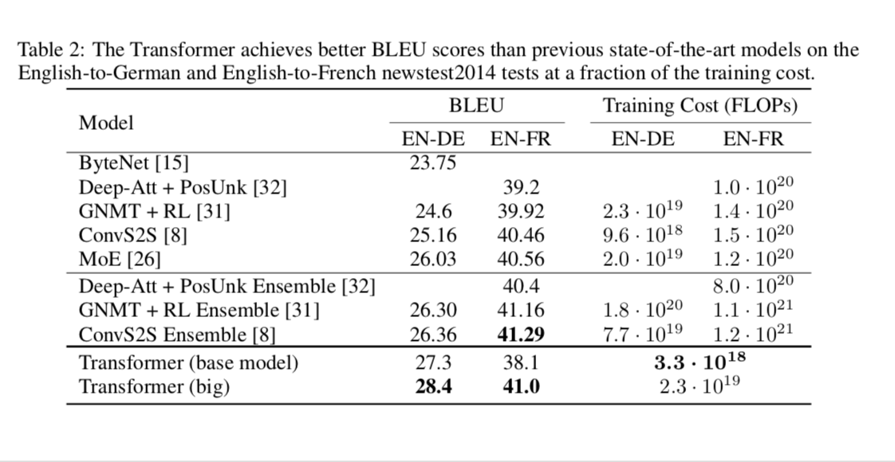
Transformer: Performance in MT

Slide 35
Transformers vs RNNs
+ State-of-the-art on most benchmarks
+ Scalable to billions of parameters (GPT3 – XX billion params)
+ Computation in parallel (feedforward network)
- Recurrence needs to be learned
⇒ lots of data required or autoregressive task
- Many parameters for suitable model necessary ⇒ can easily overfit
- Memory scales quadratically with seq length
+ Language is naturally recurrent
+ Higher non-linearity and more complex composition
⇒ Single-layer RNN outperforms single-layer transformer
- Does not scale well beyond 5 layers - Slower to run for long sequences
- Long-term dependencies problematic

